Slide 1
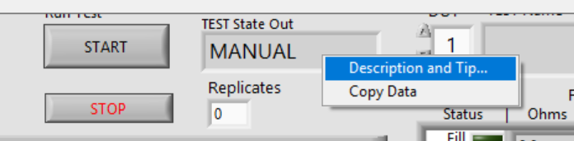
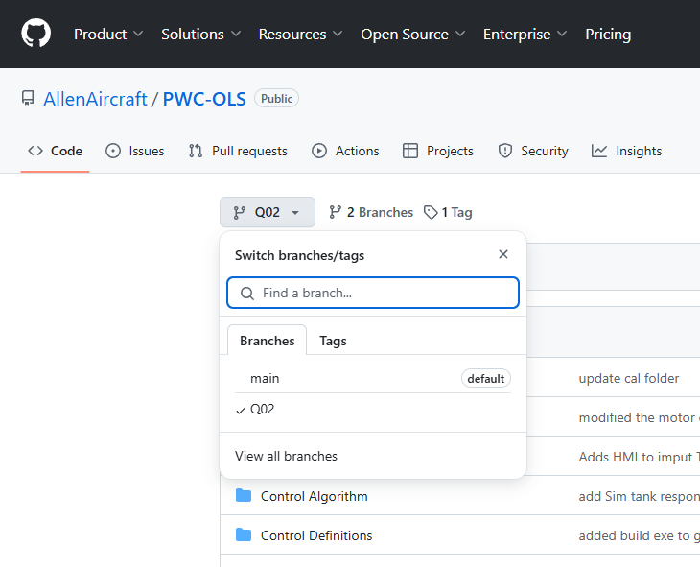
Step 2

Slide 2
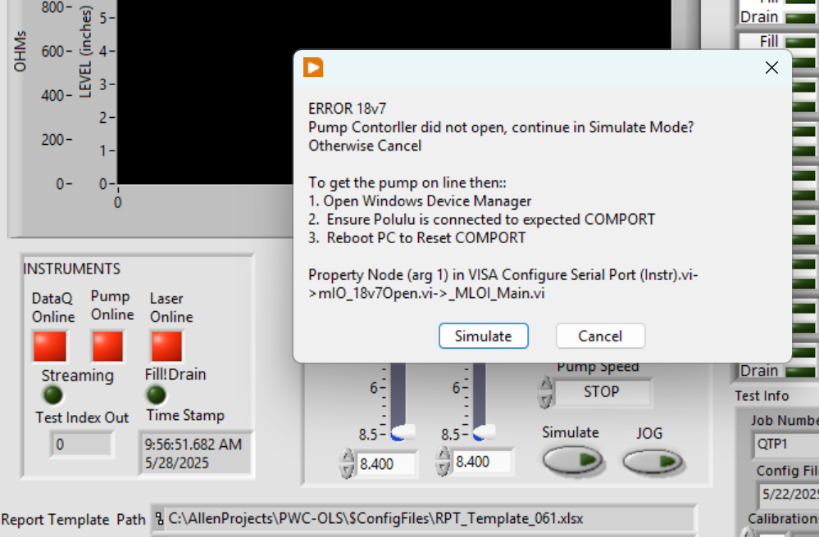
(2)
(1)

Slide 3
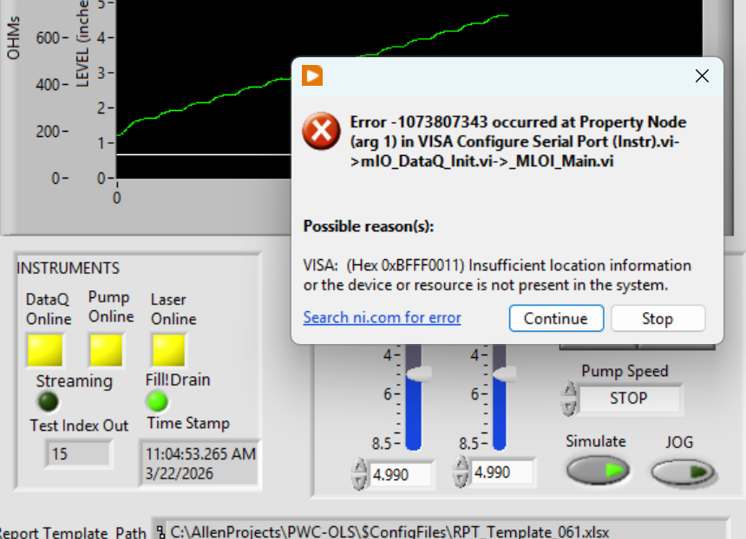
(3)
(4)
(5)

Slide 4
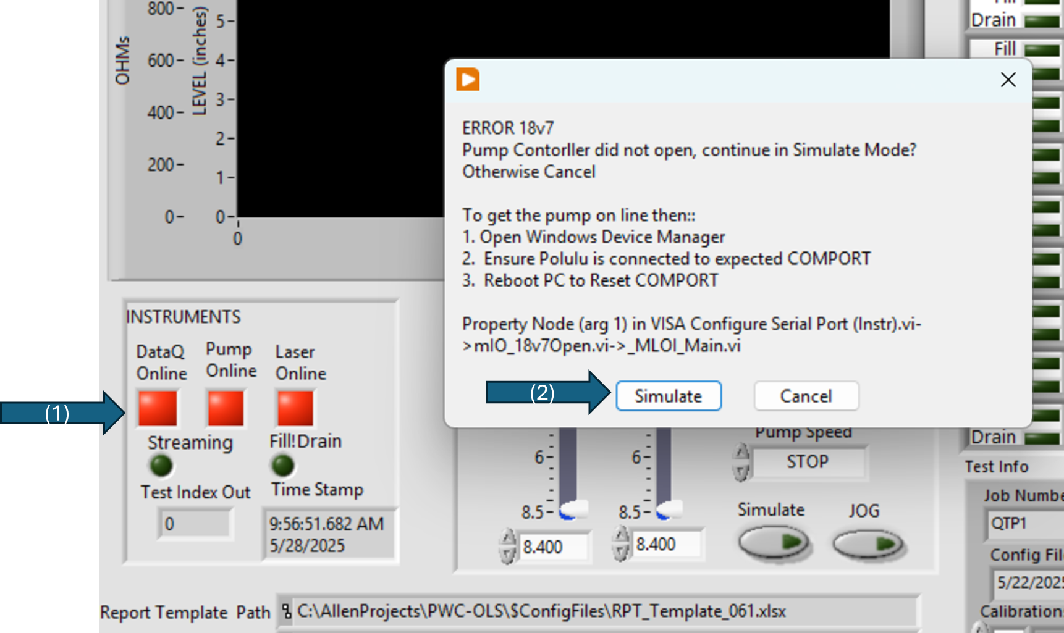
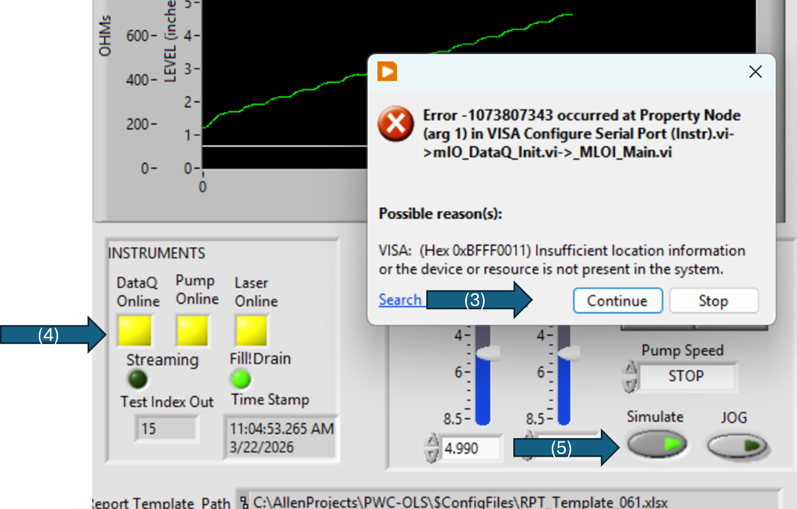

Slide 5
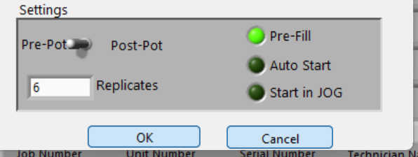
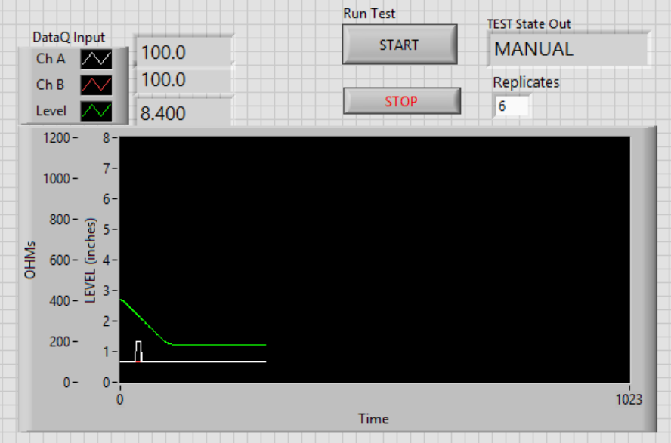
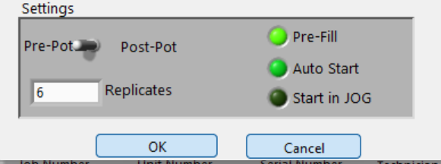
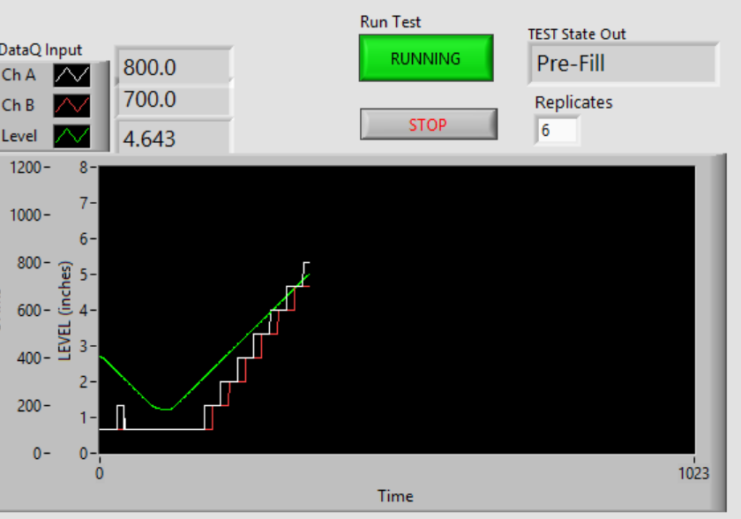
Run Test = START
TEST State Out = MANUAL
And Level Plot = Flat
Run Test = RUNNING
TEST State Out = Pre-Fill
And Level Plot = Ramping Up

Slide 6
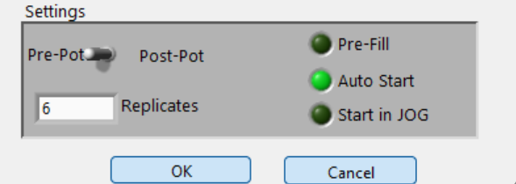
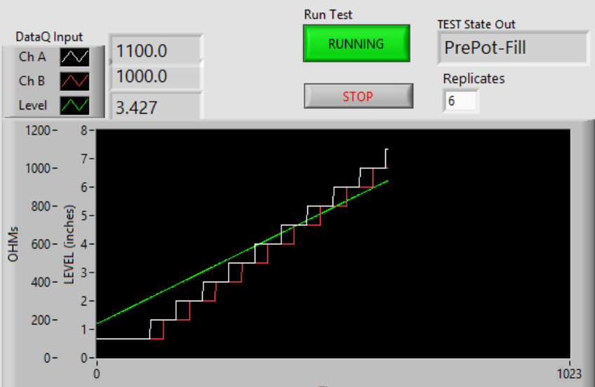
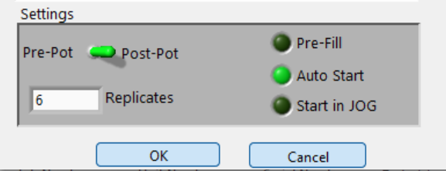
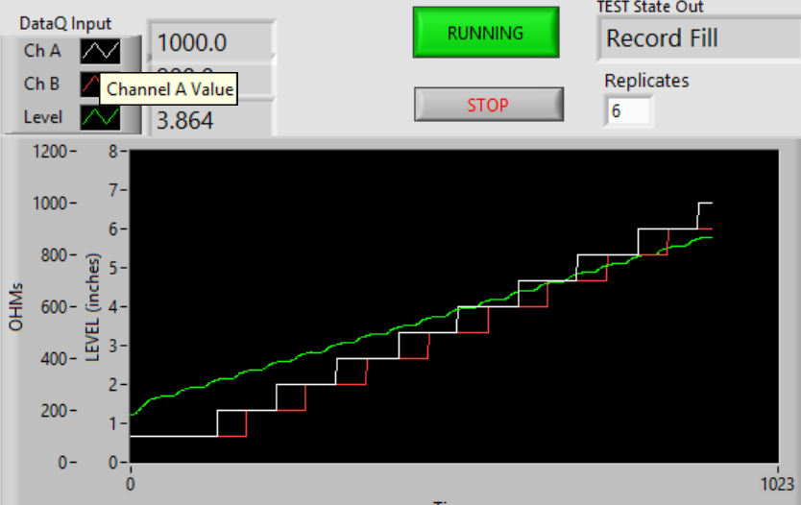
Run Test = RUNNING
TEST State Out = PrePot-Fill
And Level Plot = Slower Ramp up
Run Test = RUNNING
TEST State Out = Cycling States
And Level Plot = Stair-step up

Slide 8
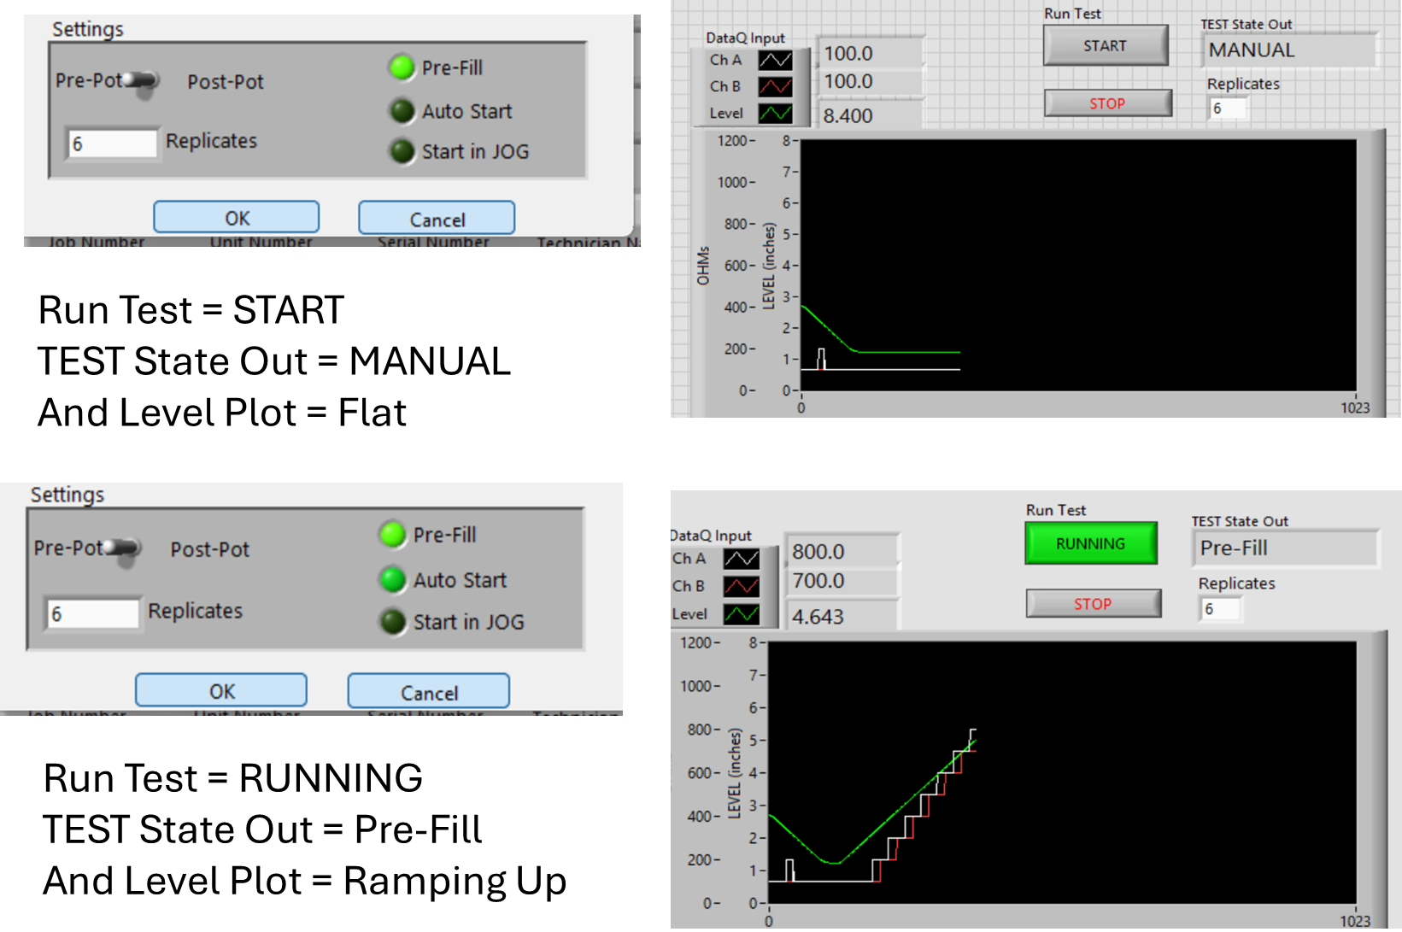
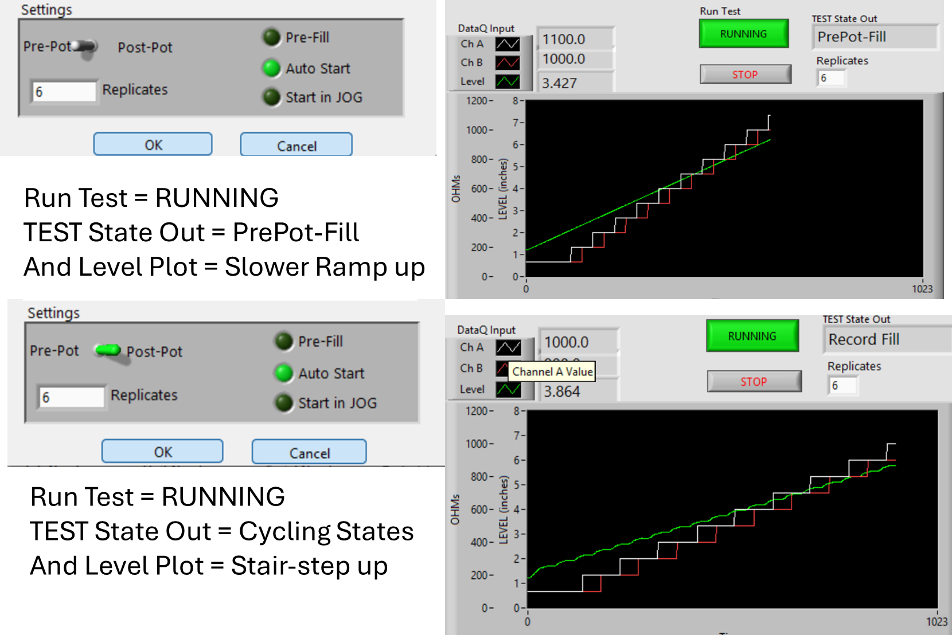

Slide 9
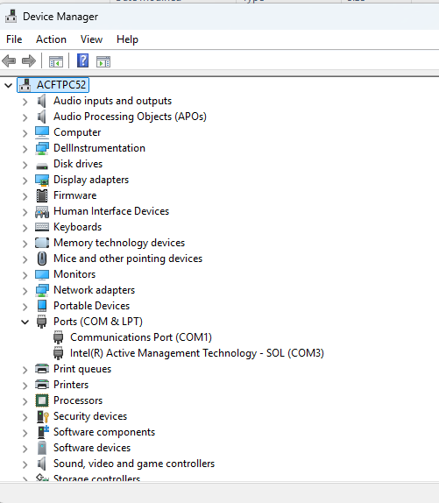
Step 2

Slide 10
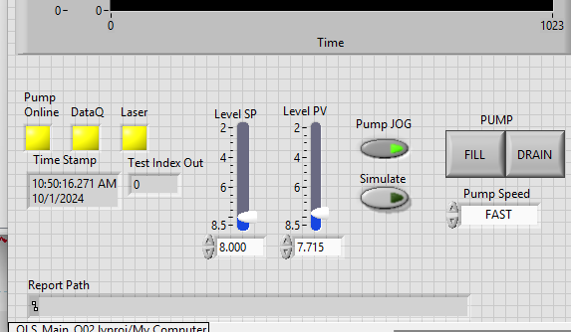
1
2
3
SIM button

Slide 11
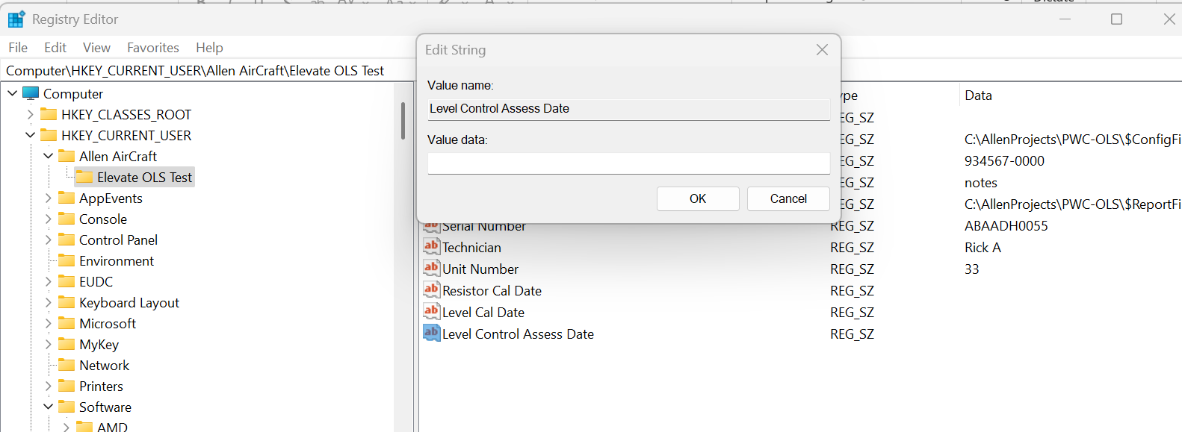
Enter date here
Navigate to this Key
Edit this Value

Slide 12
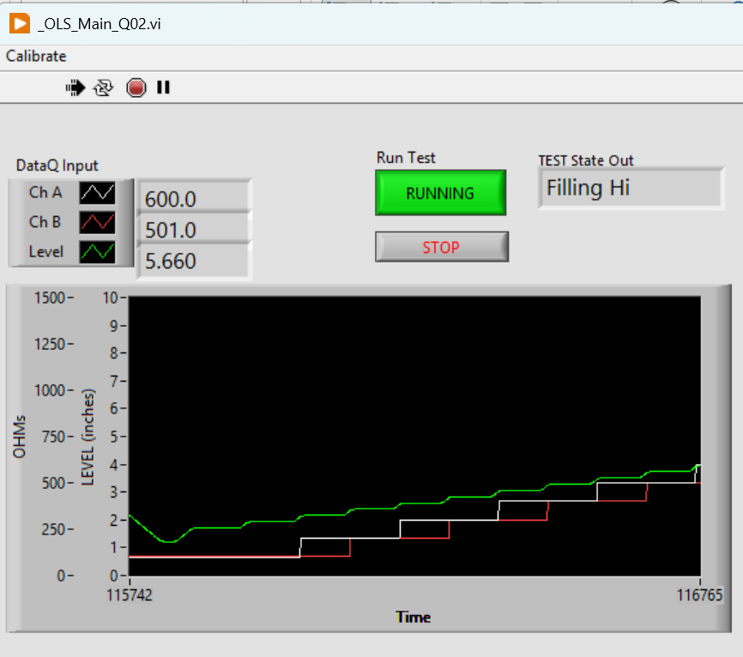
System State and Mode indicator
Click to START or END the automatic Test protocol
STOPS and Exit the application
GREEN Level
WHITE ChA
RED ChB

Slide 13
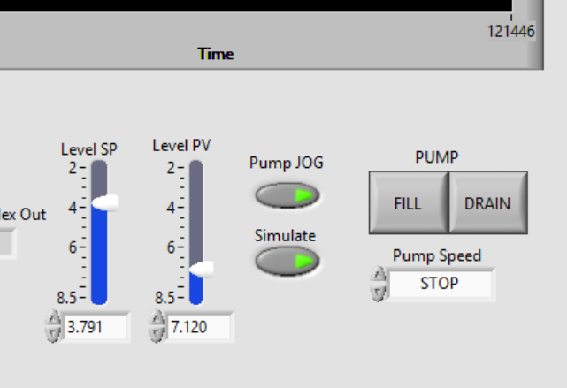
With Pump JOG button:
ON, the FILL and DRAIN buttons and the Pump Speed dropdown control the pump.
OFF then the Level (PV) goes to the SP.
Process Variable (PV) The measured Level.
Set Point (SP) The desired Level in automatic.
NOTE: SP, PV and Level indicate:
Tank is EMPTY when Level ~8.2”
Tank is FULL when Level ~ 2.4”
With Simulate ON, the Level PV and Green Plot should simulate the tank level.

Slide 14
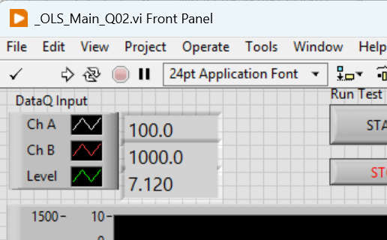
ChA Value.
ChB Value.
Level Value.

Slide 15
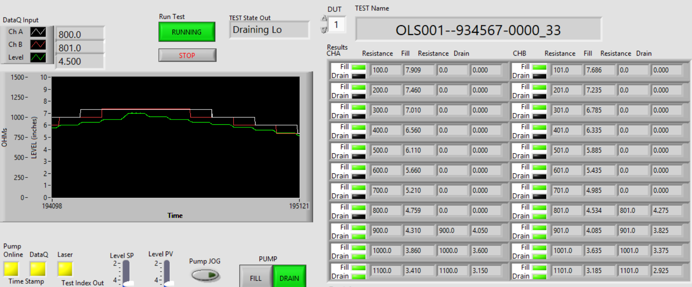
Measured Resistance
(4 places)
Measured Target Test Level
(4 places)
Current Test State
When Running (Green) The test protocol state machine sets the SP in automatic mode to create the stairstep level values.
FILL and DRAIN Status lights,
GREEN = PASS
RED = FAIL
YELLOW = Test Error
BLACK = Not Tested
ChA FILL
ChA DRAIN
ChB FILL
ChB DRAIN

Slide 16
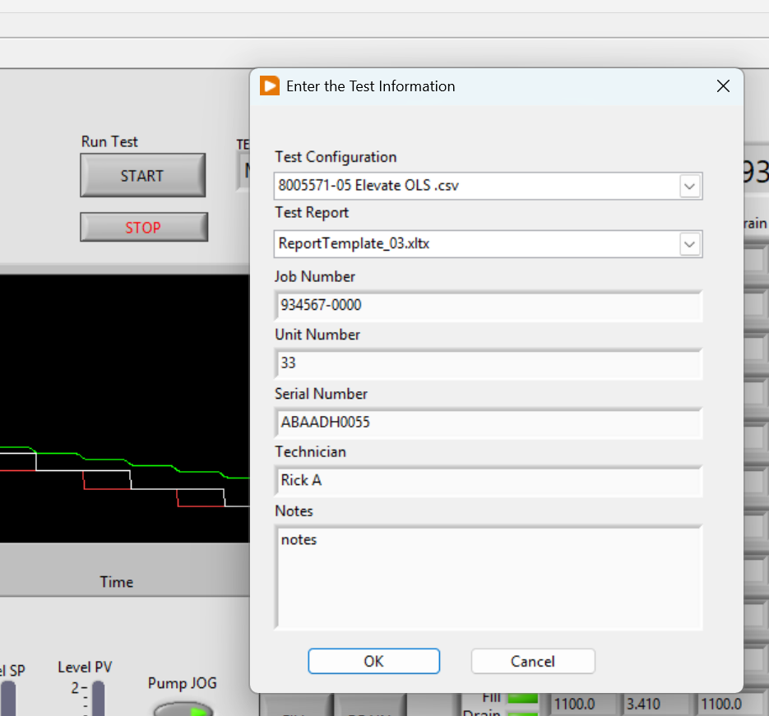
Test Information Dialog
STOP and Exit button.
Test Information Fields (7 Places)

Slide 17
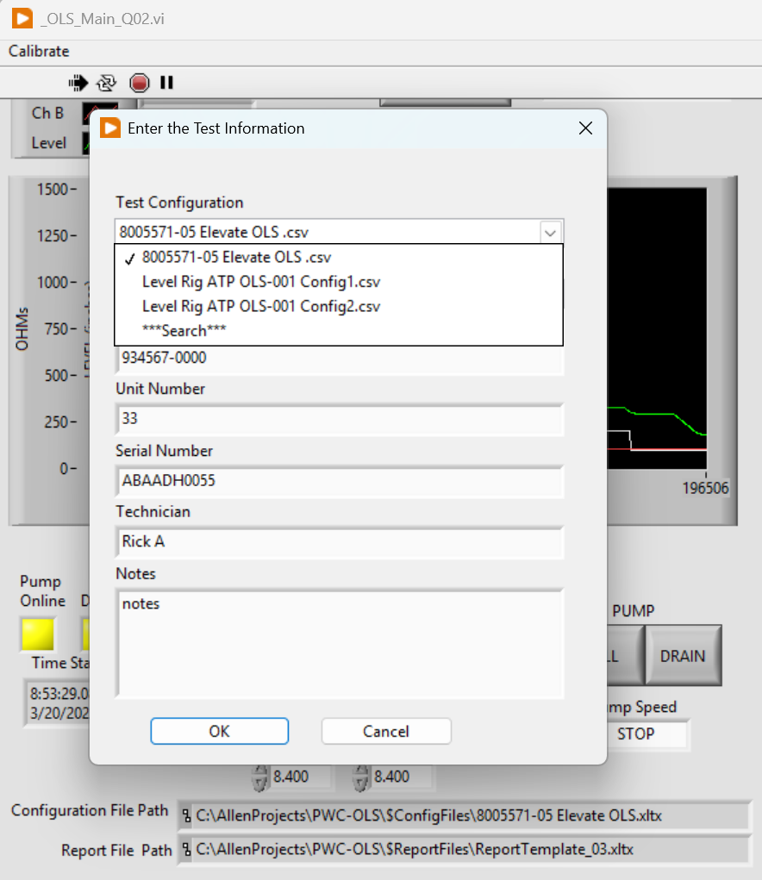
Config File Selection Field
Saved in Register
Currently Selected
Available Selection in current folder
Change Folder
Currently Selected
Full Path & Name

Slide 18
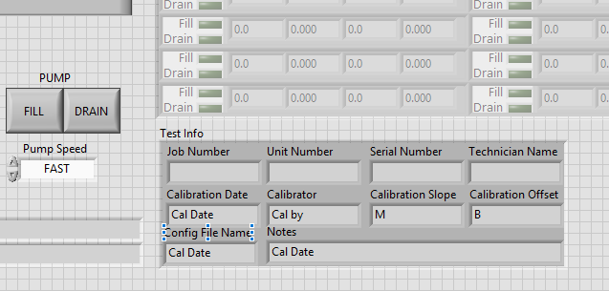
Test Information

Slide 19
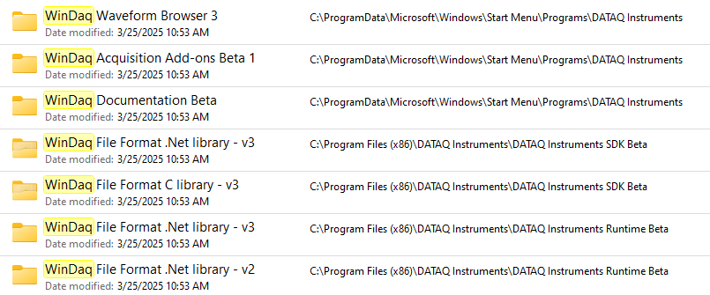
WinDaq Data Acquisition Software
PicoScope oscilloscope software and PicoLog data logging software
Pololu Simple Motor Controller 18v7 (Fully Assembled)

Slide 20
Switching between LibUSB and CDC Modes The native communication mode of the DI-2108-P is LibUSB but it can be switched to the USB CDC (Communication Device Class). CDC mode allows the USB port of DI-2108-P devices to appear like a traditional RS-232 port, which is common across most operating systems and development languages. Please note: LibUSB communication is required for WinDaq Acquisition software and programming with our .NET SDK. Only switch to CDC mode when writing your own programs at the protocol level (for example, Python applications). Use the following sequence to switch your device to/from LibUSB/CDC modes:
Connect the device to your PC via the USB port.
Apply power to the device.
When mode LED stops blinking white and is in Idle mode, push and hold the Control button. This must be completed within five seconds after the device is in Idle mode.
When the mode LED turns red, release the Control button. 5. The Mode LED will flash white then indicate Idle in either LibUSB or CDC mode: • CDC mode: Blinking Yellow • LibUSB mode: Blinking Green

Slide 21
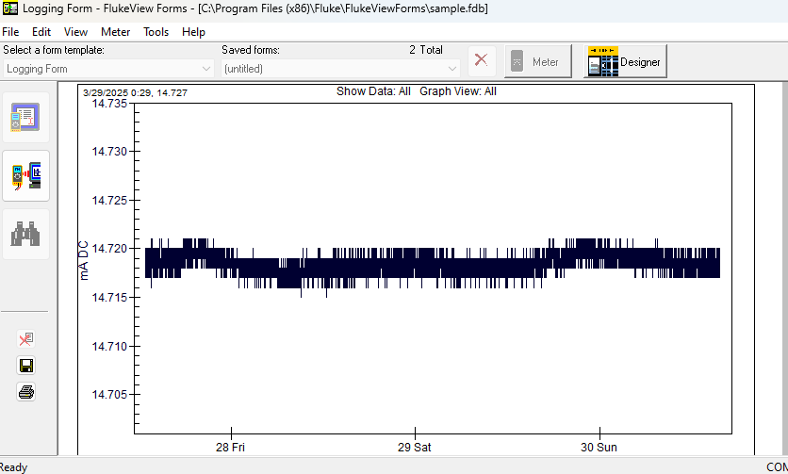
Fluke mA 3/28 to 4/1

Slide 22
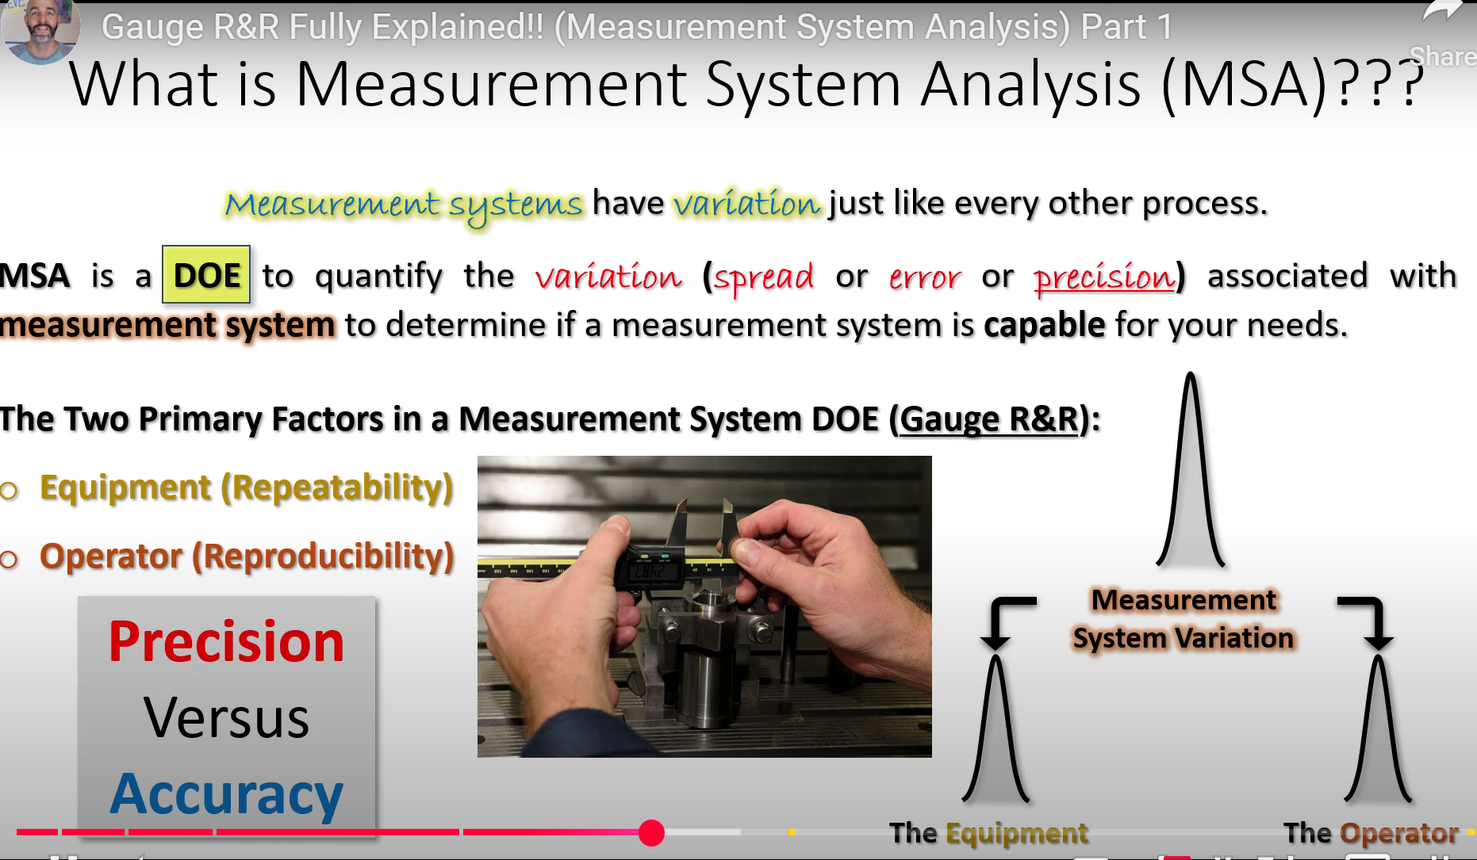
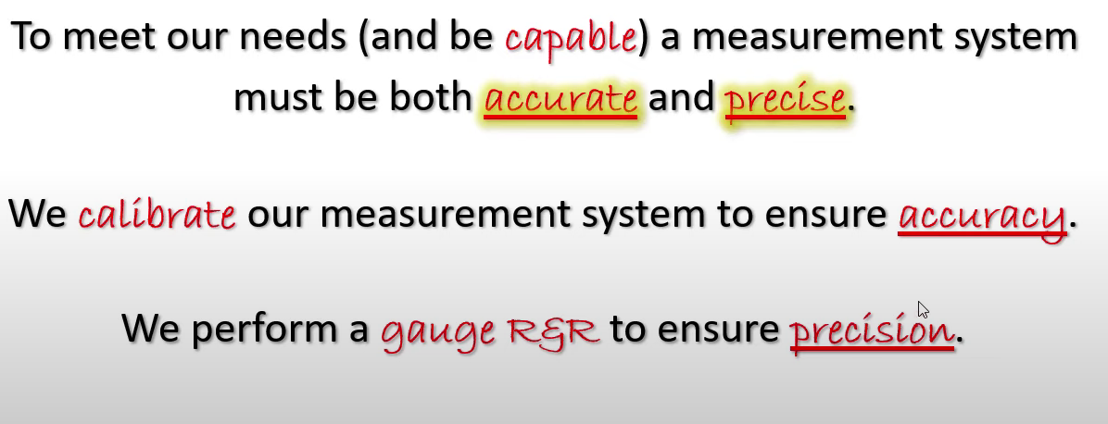
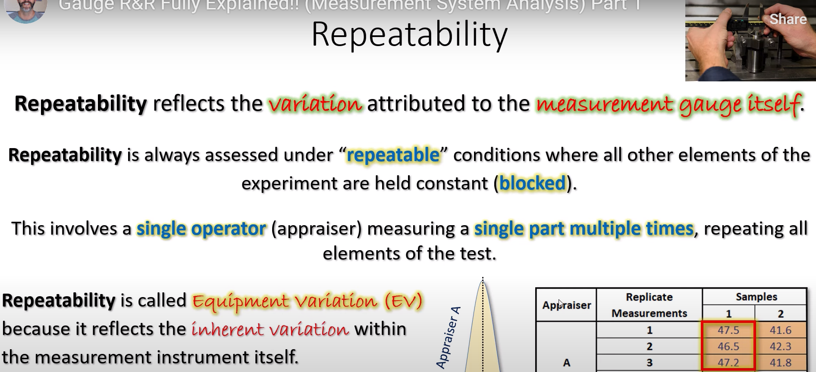
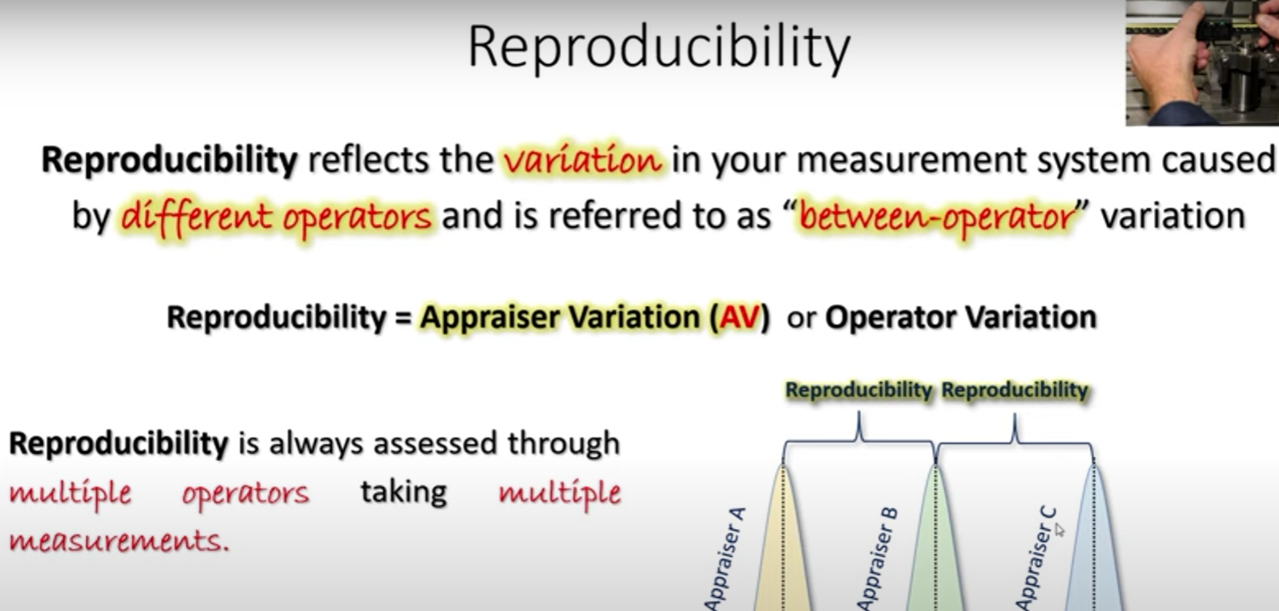

Slide 23
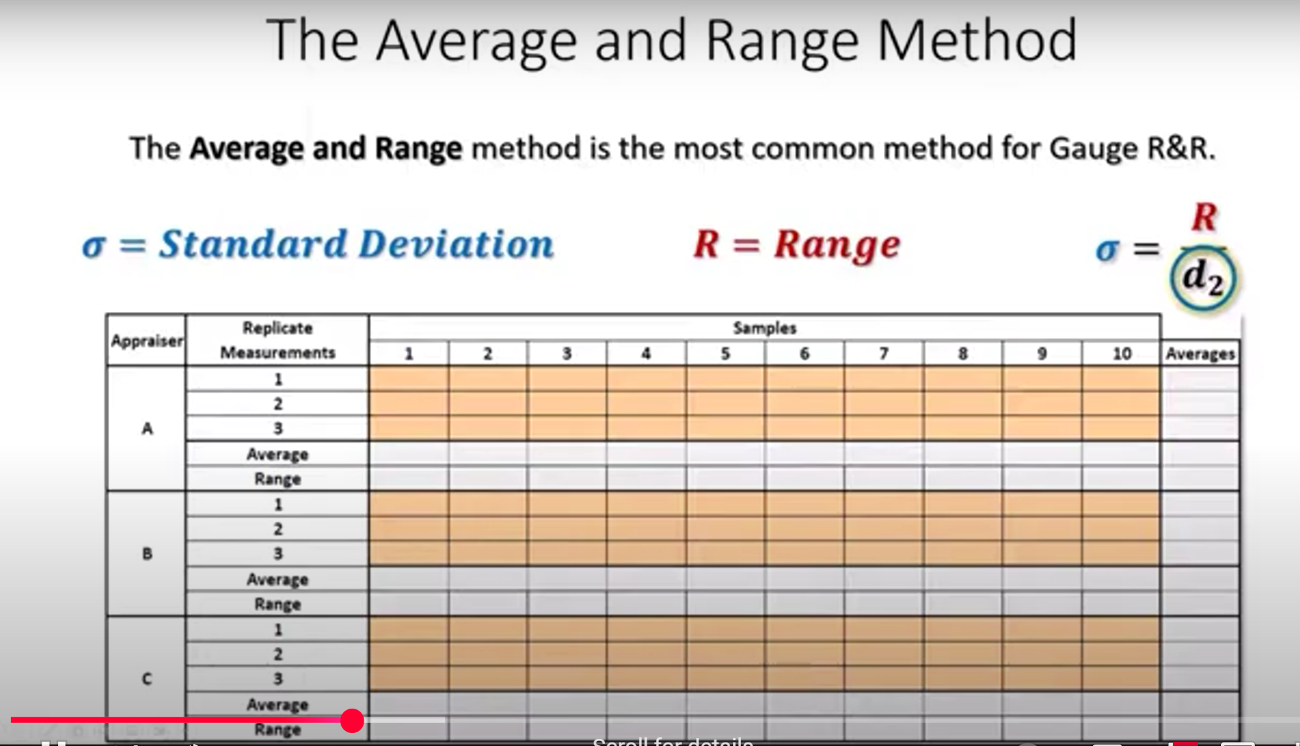
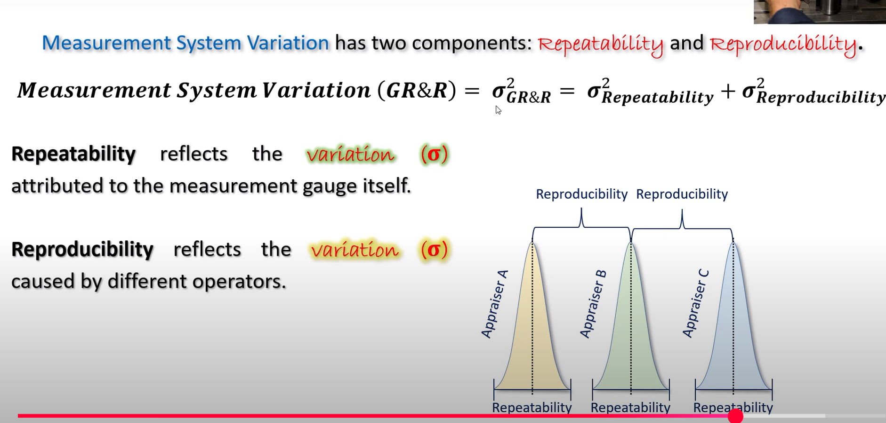
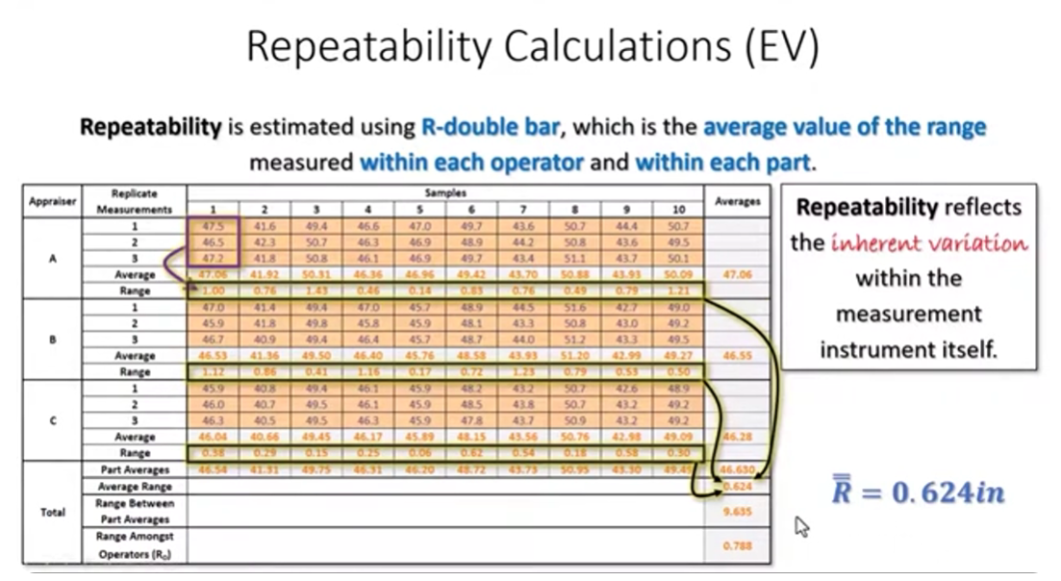
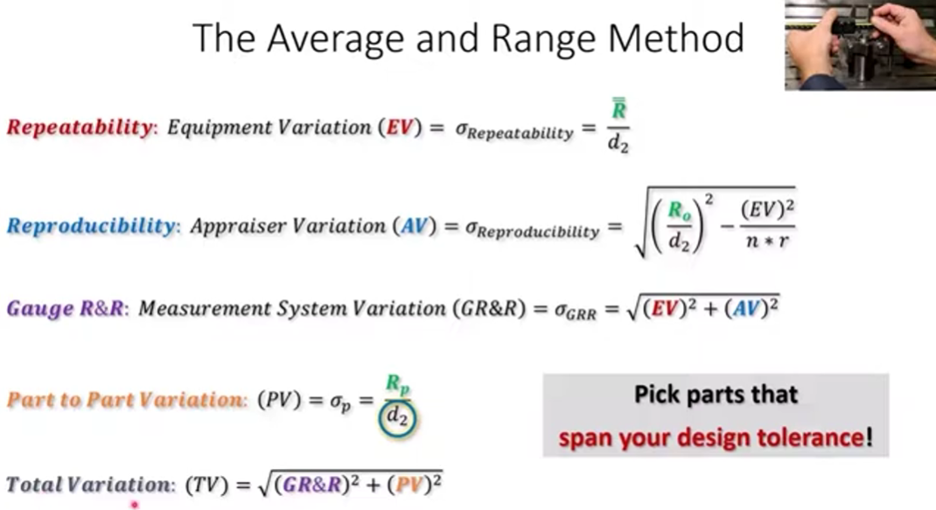

Slide 24

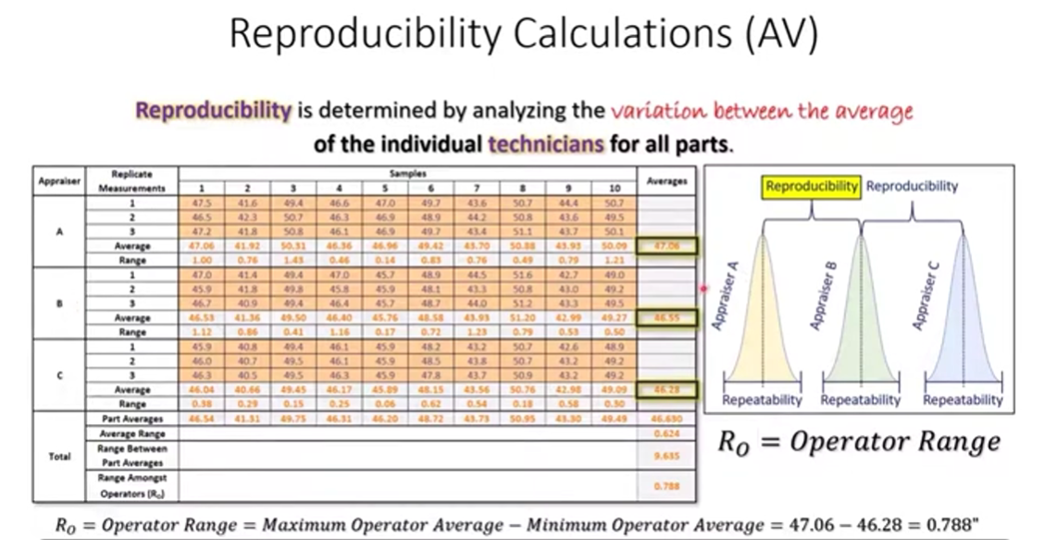



Slide 25

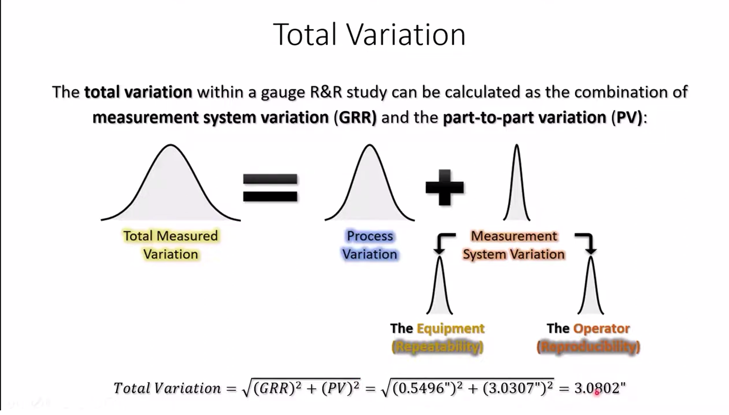

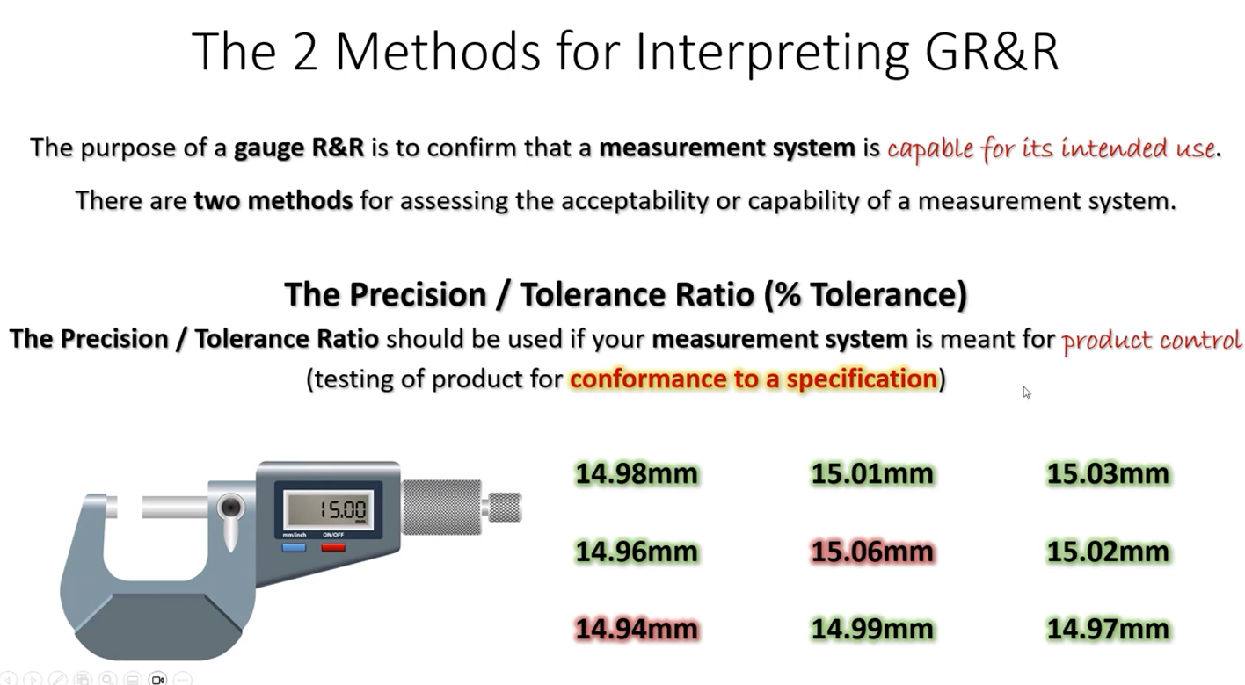
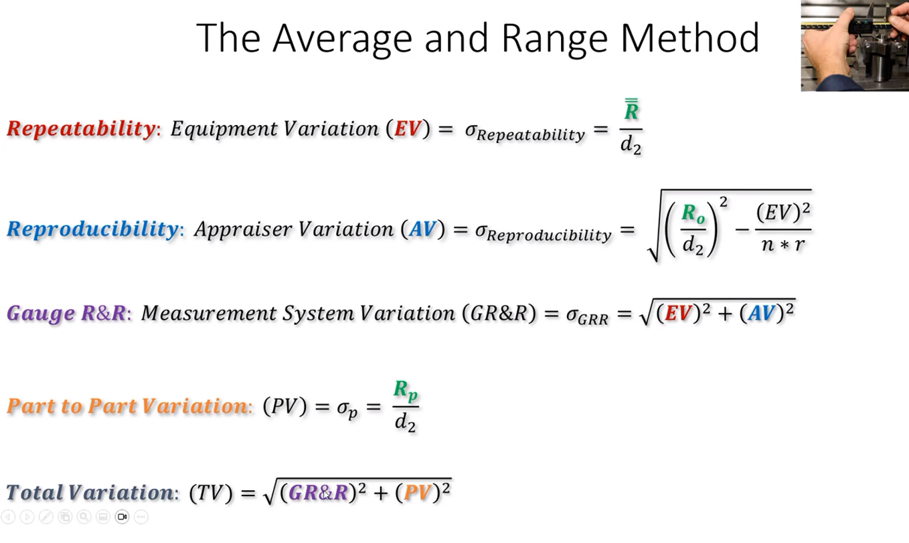

Slide 26
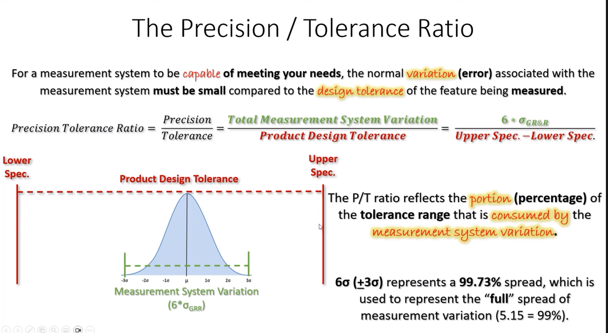
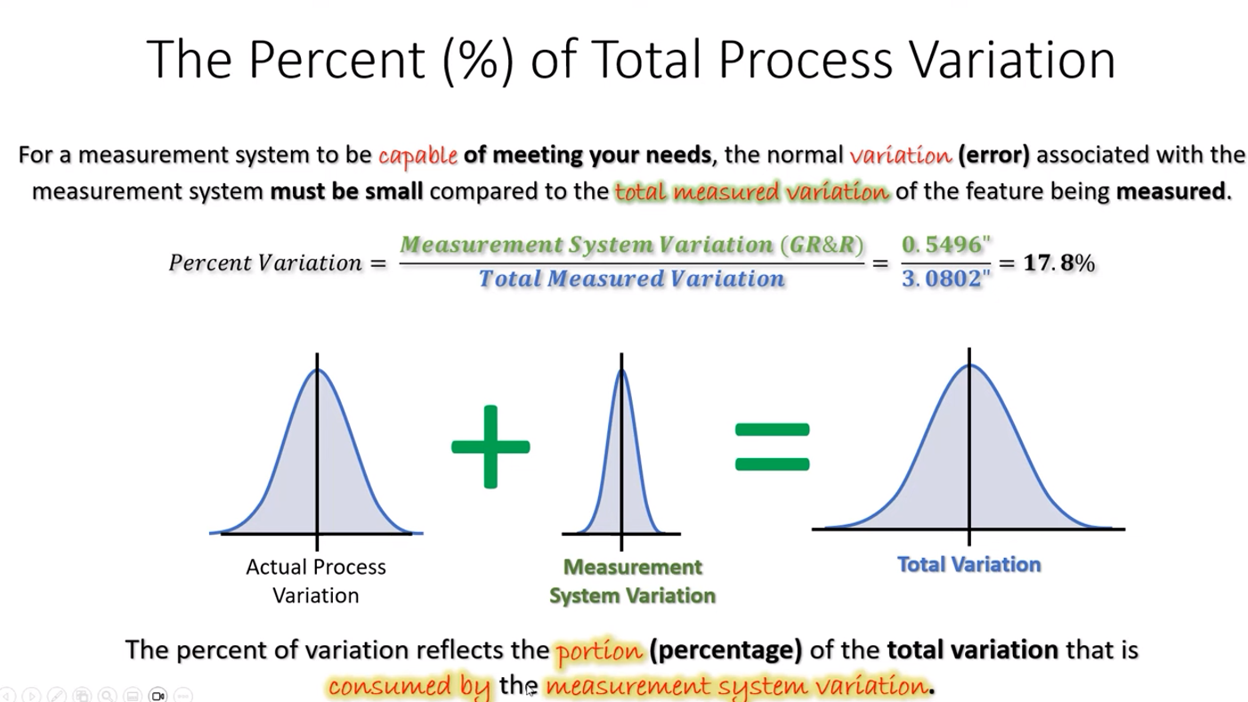

Slide 27
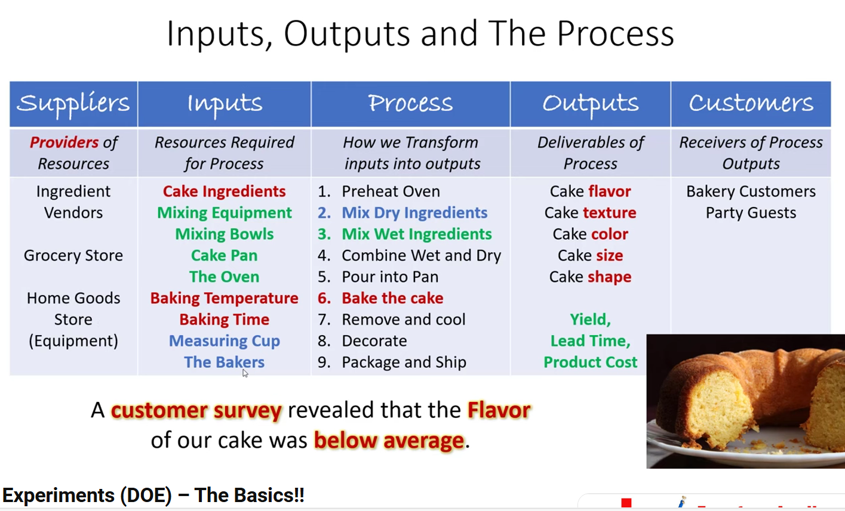
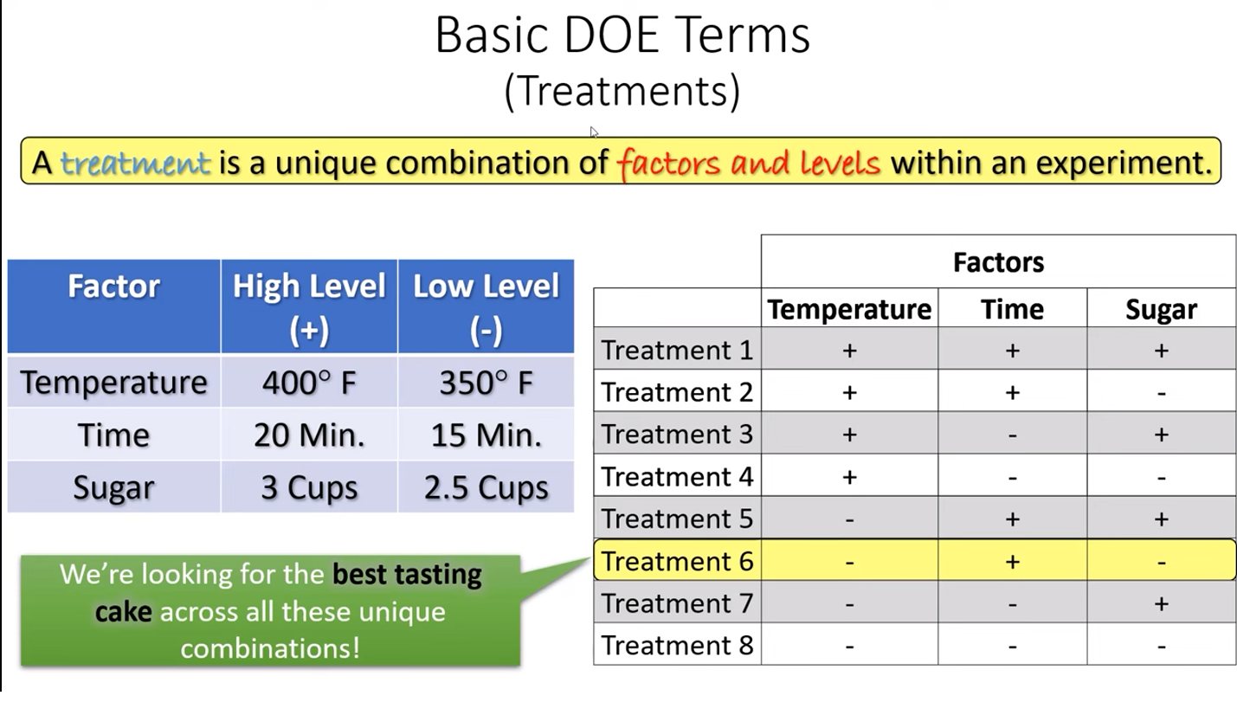
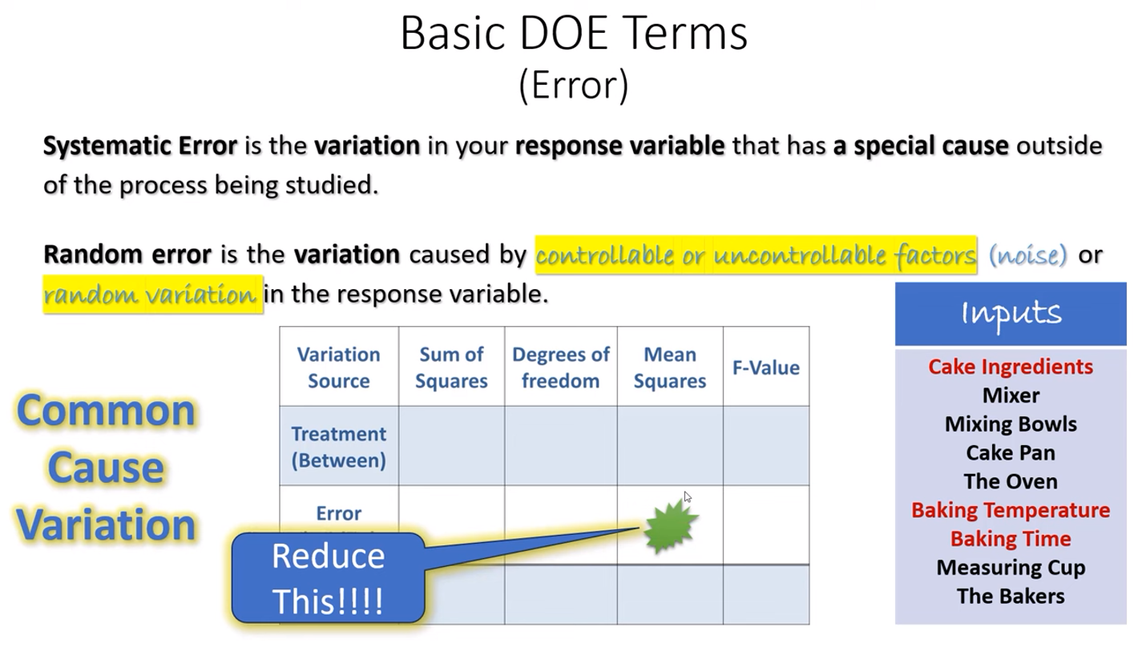
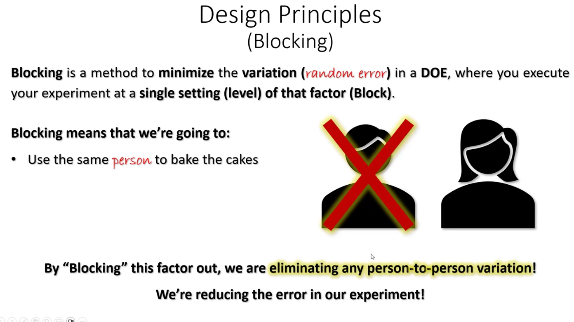
DOE SIPOC
DOE Design Matrix

Slide 28
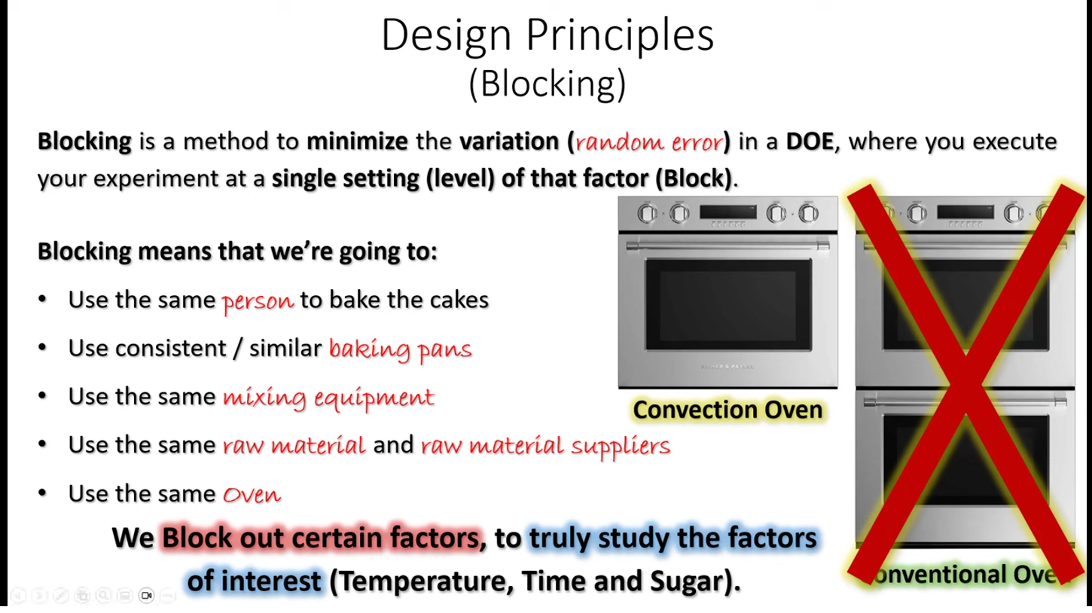
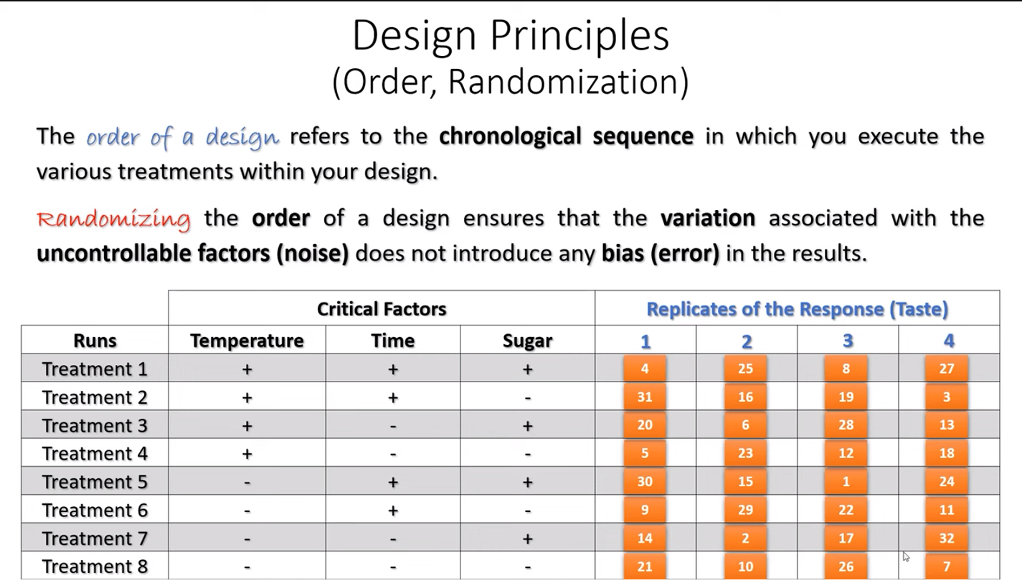

Slide 29
